Slide 1
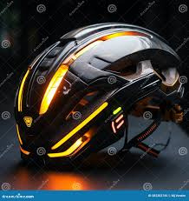
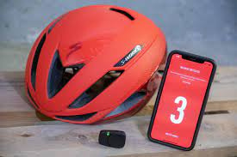
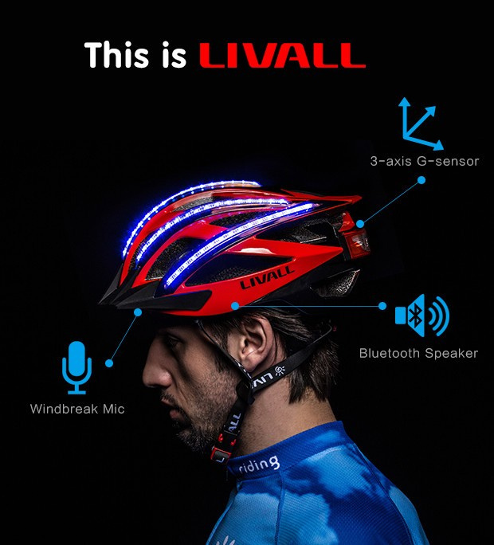
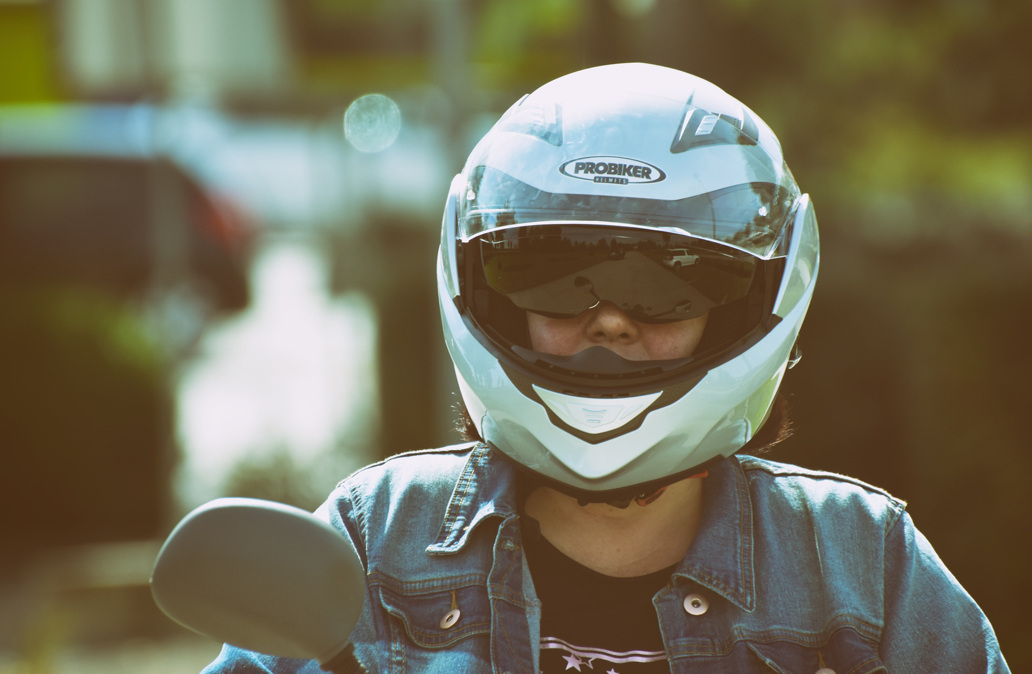
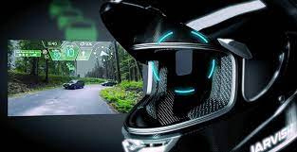
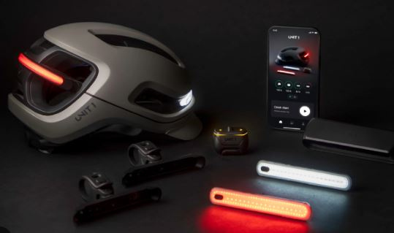
THE BELIEVERS
PRESENTS-
CYBER - TECH
HELMET
PROBLEM STATEMENT:-
Ideas focused on the intelligent use of resources for transforming and advancements of technology with combining the artificial intelligence to explore more various sources and get valuable insights.

Slide 2


THE BELIEVERS
PRESENTS -
CYBER-TECH HELMET
PS Code: SIH1482
Problem Statement Title: Student Innovation
Team Name: the believers
Team Leader Name: ADITYA SHARMA
Institute Code (AISHE): C-46111
Institute Name: KIET GroUP OF INSTITUTIONS
Theme Name: smart automation

Slide 3

TEAM - THE BELIEVERS
Title : CyberTech Helmet
Team Leader : ADITYA SHARMA
Branch : B.Tech Stream : CSIT Year : II
Team Member 1 : Shagun Goel
Branch : B.Tech Stream : CSIT Year : II
Team Member 2 : Rohit Halsana
Branch : B.Tech Stream : CS Year : II
Team Member 3 : Agnik Saha
Branch : B.Tech Stream : IT Year : II
Team Member 4: Pari
Branch : B.Tech Stream : CSEAI Year : II
Team Member 5 : Shreya Dixit
Branch : B.Tech Stream : CS Year : II

Slide 4
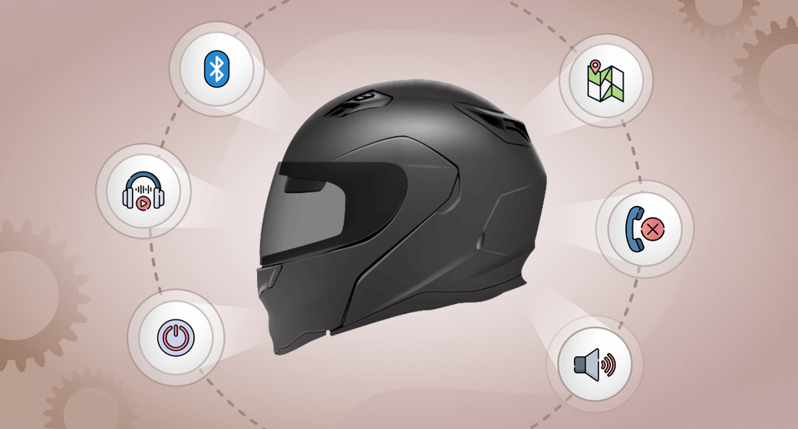

CYBER-TECH HELMET
Traditional helmets, while effective in protecting users from head injuries, often fall short in meeting the demands of modern consumers.
To bridge this gap, our CyberTech Helmet seeks to identify and address key issues related to traditional helmets.
Safety Enhancement: Utilizing advanced materials, impact-absorbing technologies, and innovative design, the CyberTech helmet offers substantial protection .
Connectivity and Communication: It connects wirelessly with smartphones and other wearables to improve communication.
Visibility : It offers enhanced visibility in various conditions, such as low light or adverse weather.
Augmented Reality (AR): Integration of AR technology for navigation and real-time information display improves user experience.
Regulatory Compliance: CyberTech Helmet adheres to a complex web of safety standards and regulations.
TECHNOLOGY USED:
IOT
AI
AR
ANDROID
DATA SCIENCE
ML

Slide 5



FEATURES OF CYBER-TECH HELMET
DEPENDECIES AND STOPPERS
Fall Detection
Distance Sensing
Alcohol detector
Live-Streaming
Object Detection
Speech recognition
Bluetooth Connectivity
GPS Navigation
Auto calls nearest hospital
Helmet-required Vehicle Ignition
Low Bandwidth Issues
Background Disturbances
Huge Data for Data Training for Object Detection
Costly
Maintenance
Increased Weight Management

Slide 6


T E A M : THE BELIEVERS

